Slide 1

Marriage Rate Decline

Slide 2
Research Questions
How do socioeconomic factors influence marriage rates?
How have changing societal attitudes like single parenting delayed or marriage choices and priorities such as career development affected marriage rates over the time?

Slide 3
Data Source
OECD FAMILY DATABASE
WORLD BANK INDICATORS
UNDP HUMAN DEVELOPMENT REPORTS
UN ORG

Slide 4
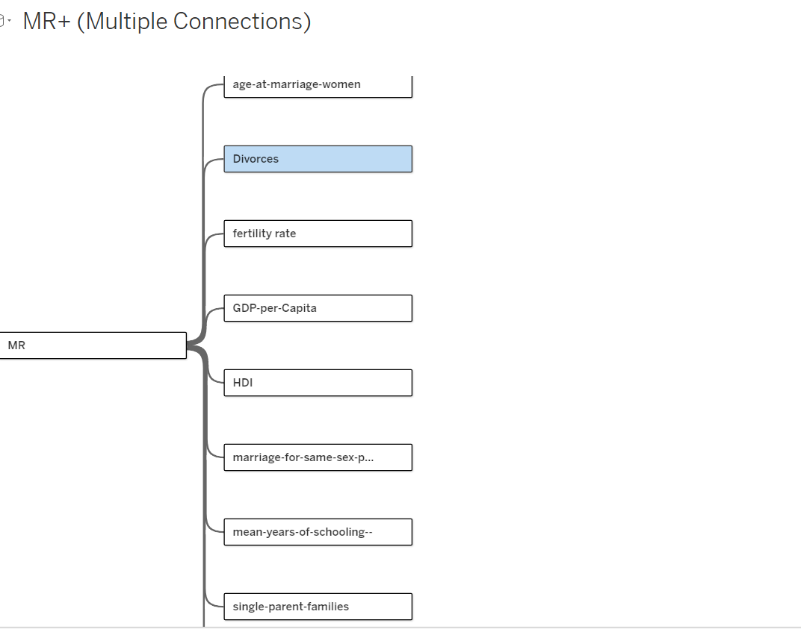
TABLES AND LINKS

